Slide 1
DECENTRALIZING FINANCE: [Financial Access Global]
Empowering You to Take Control of Your Finances

Slide 2
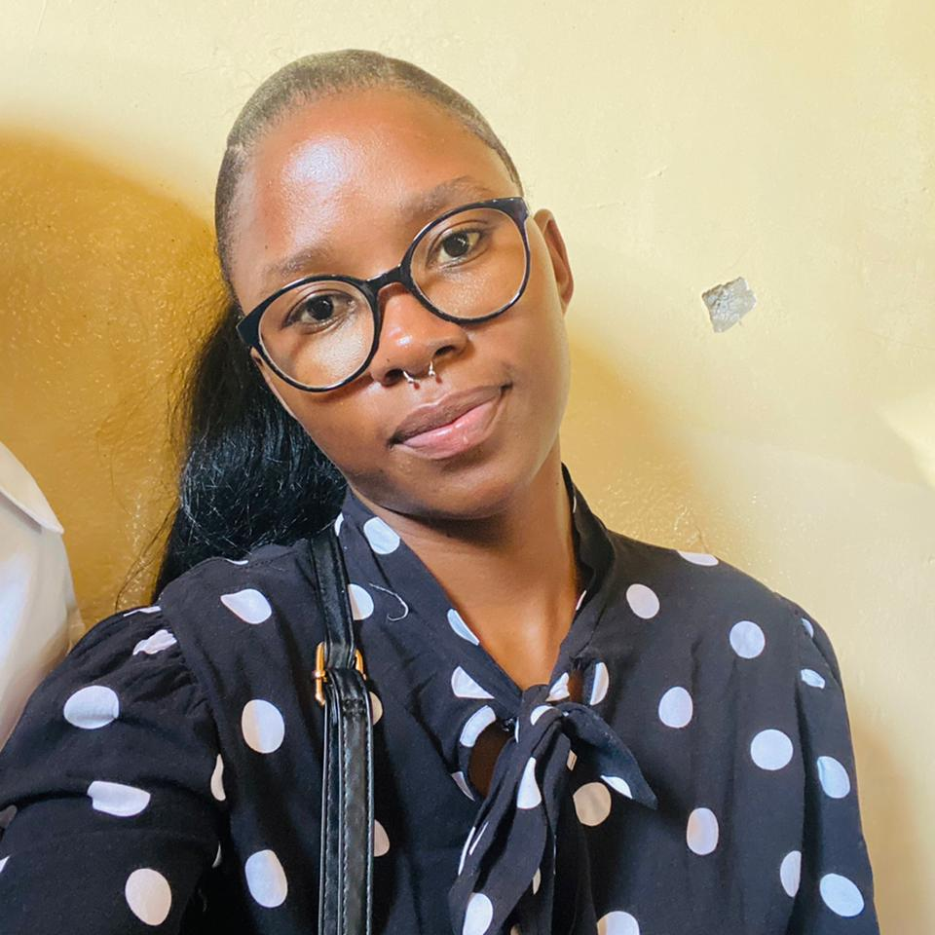
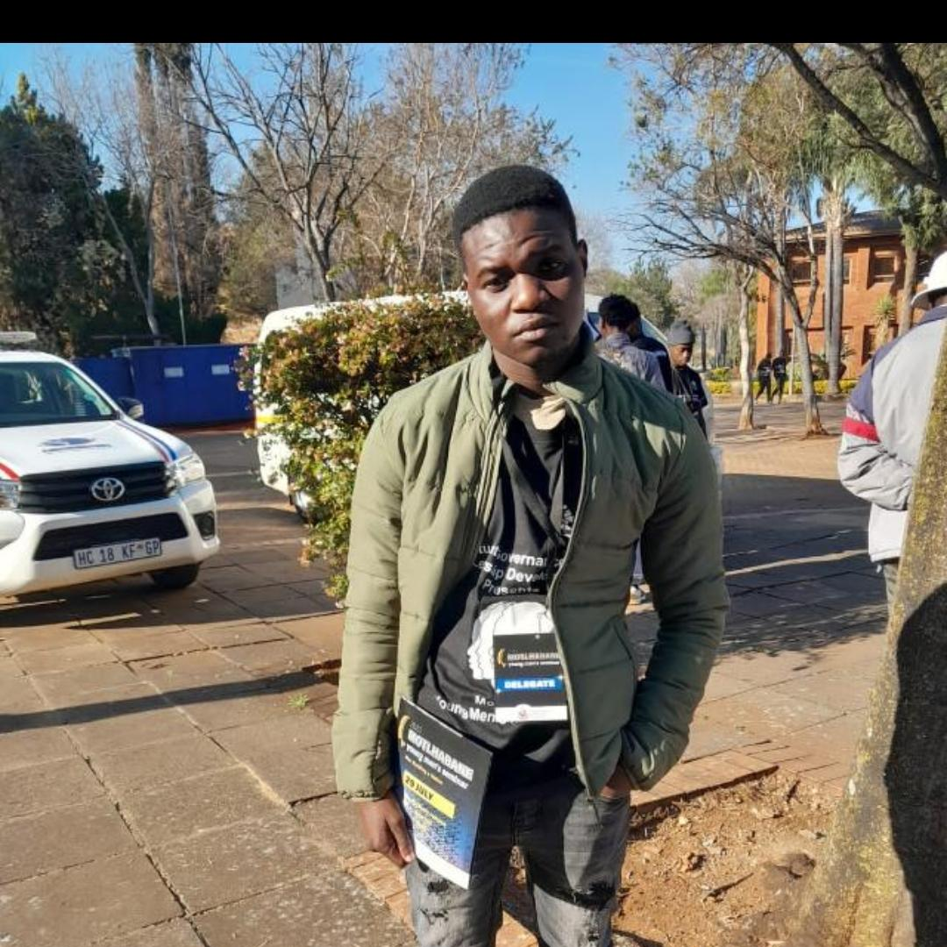


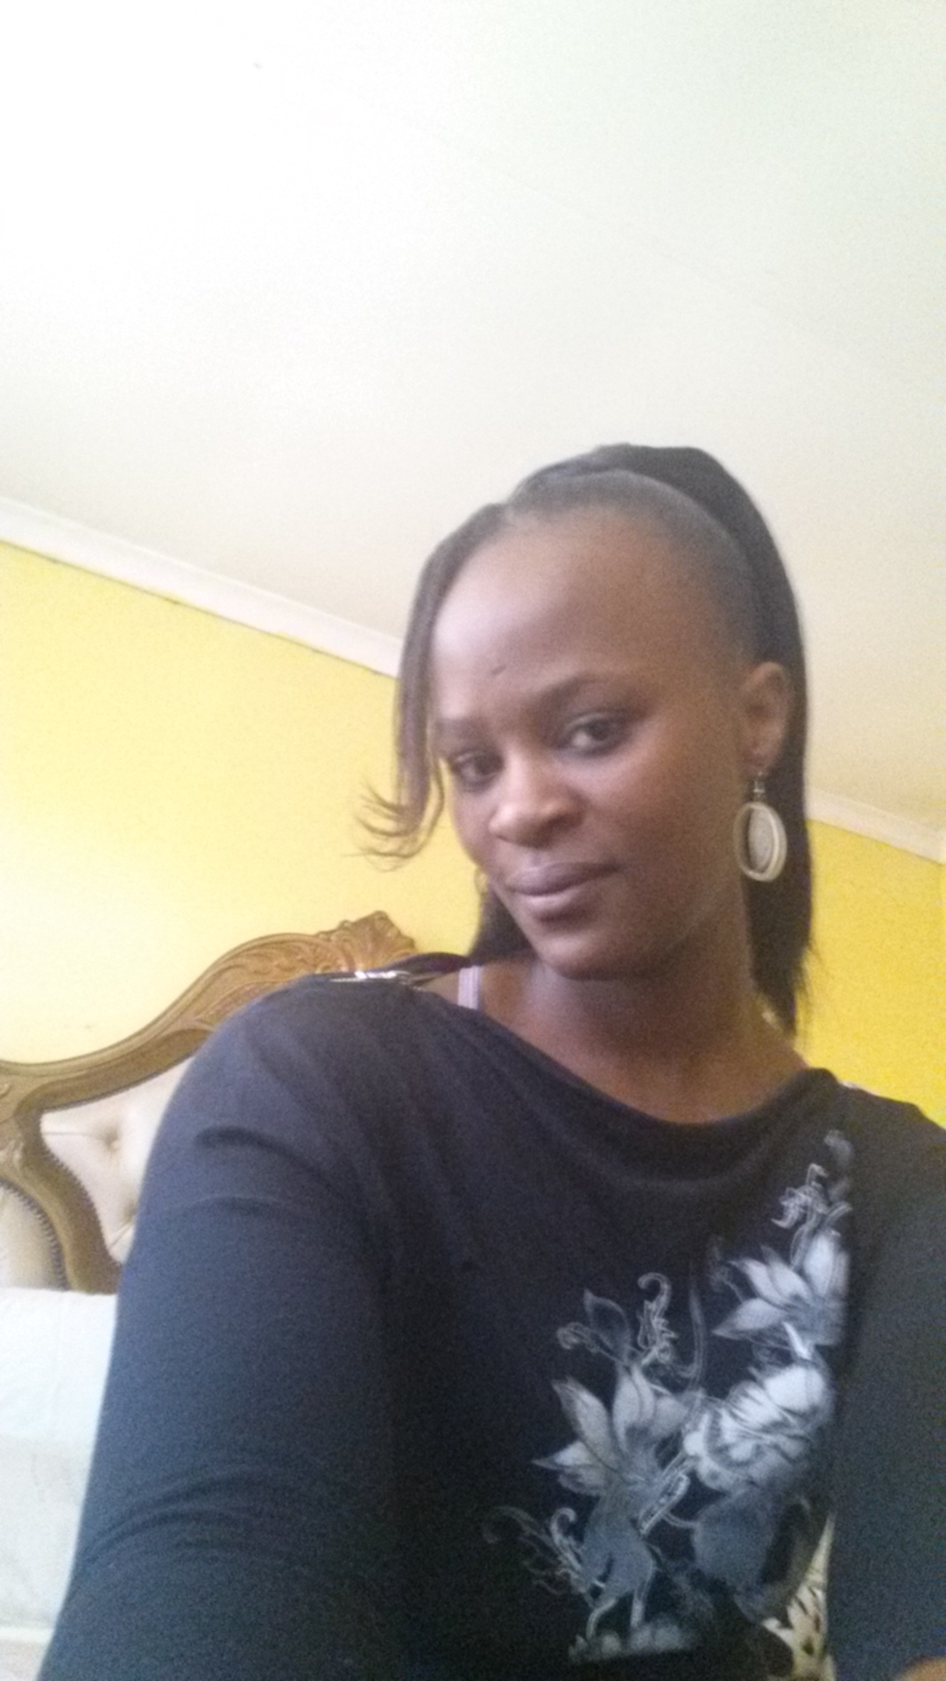
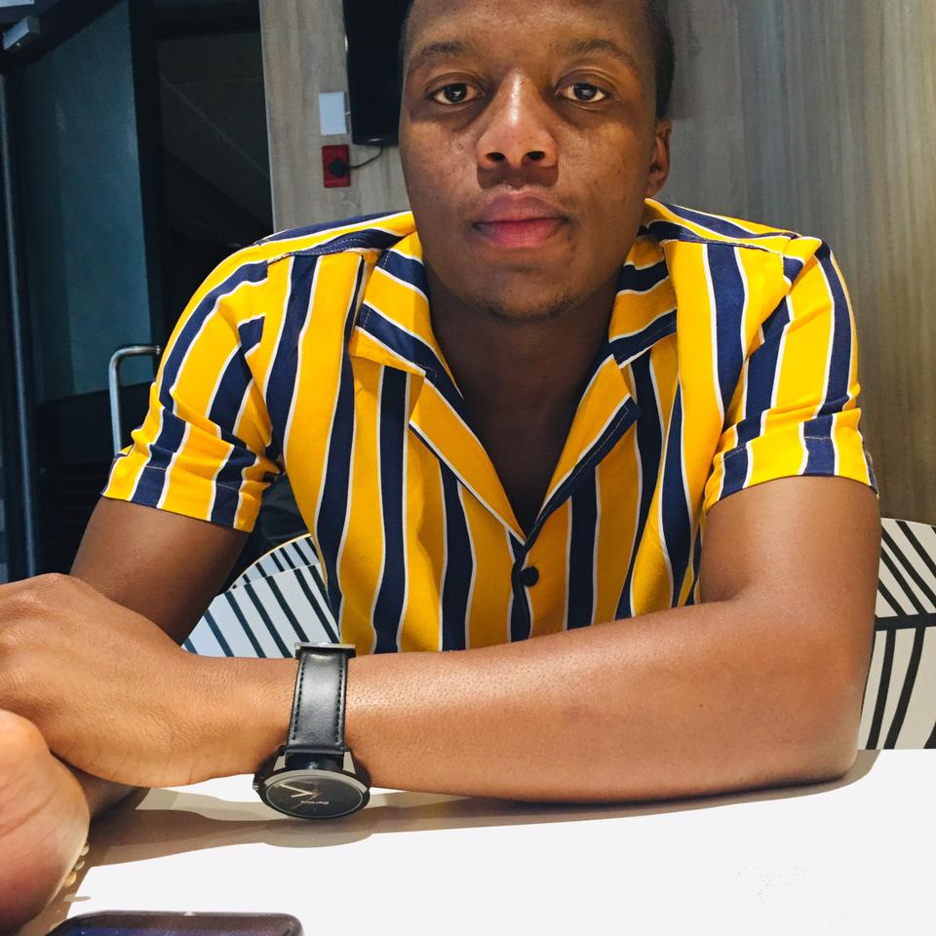
Meet our hardworking and dedicated team
Lungile Zulu
David Masiya
Sinethemba Mtubane
Kgotso Mphahlele
Leader/Project Manager
Mobile App Developer
Business Analyst
UI/UX Designer
Gontse Masebe
Khutso Mphiwe
Content writer
Back-End Developer

Slide 3
INTRODUCTION
What is Decentralized
We are introducing a blockchain wallet feature in Banking Apps that will permits direct transactions between two parties without the use of a middleman
Why is it Important
Compared to conventional centralised systems, it offers better financial inclusion, transparency, and security.
Solution
Financial Access Global – it will decentralize finance feature that empowers users to have full control of their finances

Slide 4
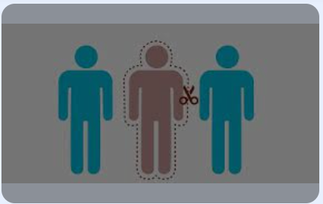
Problem statement
Intermediaries and high fees
Middlemen and transaction fees reduce the efficiency and affordability of financial services.
Limited Access to Financial Services
Billions of people worldwide lack access to banking and other financial services

Slide 5
Solution Overview
Real time payment process: Implementing real time transactions processing to reduce delays in payment process.
The feature is using a variety of techniques and technology to ensure quick and error free interaction with customer
Customer verification: verify the identity of the user and their information

Slide 6
Describe how your product solves problem
Low cost: The use of intermediaries can result in lower transaction fees and operation expenses, which can save money for both clients and enterprises.
Global Accessibility: Our feature is accessible from anywhere in the globe, which makes it simple for business cater to a worldwide clientele.
Reduce Delays: it allows immediate payment.
Transparency: Customer can have confidence and trust in the transaction process since transactions on a blockchain are transaction and traceable.

Slide 7
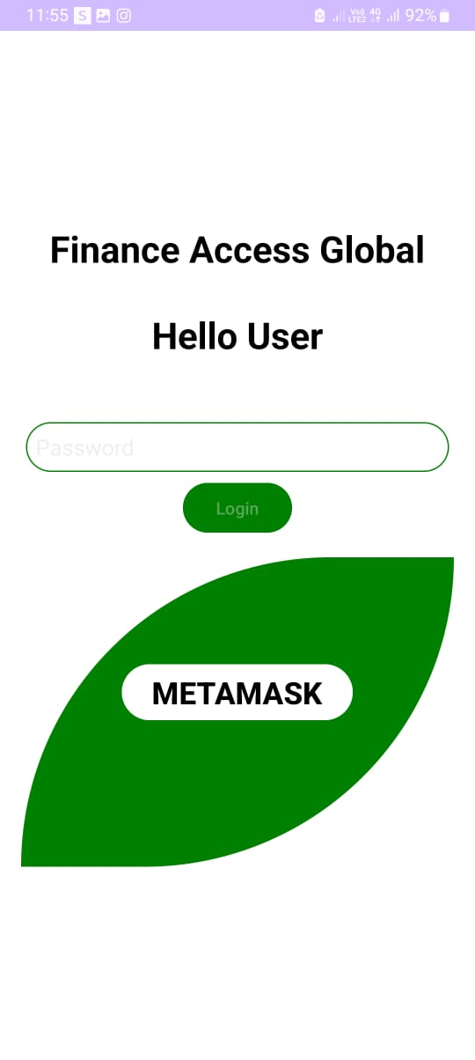
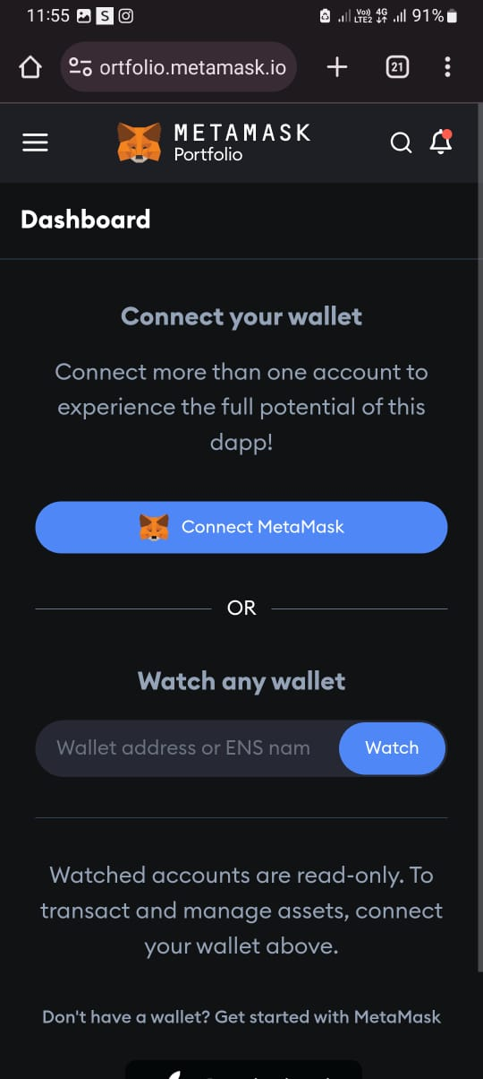
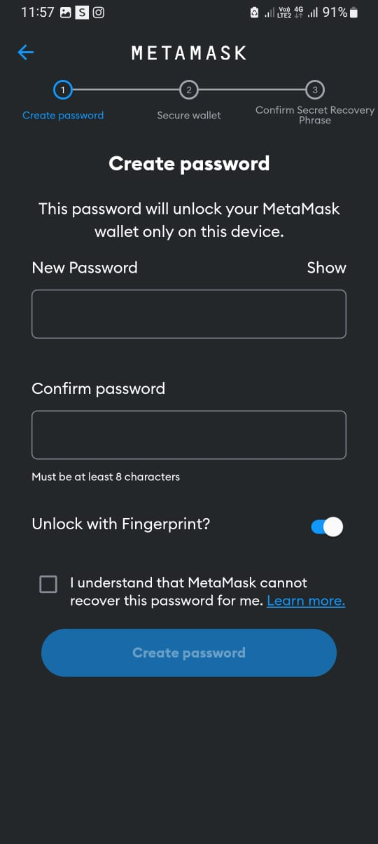
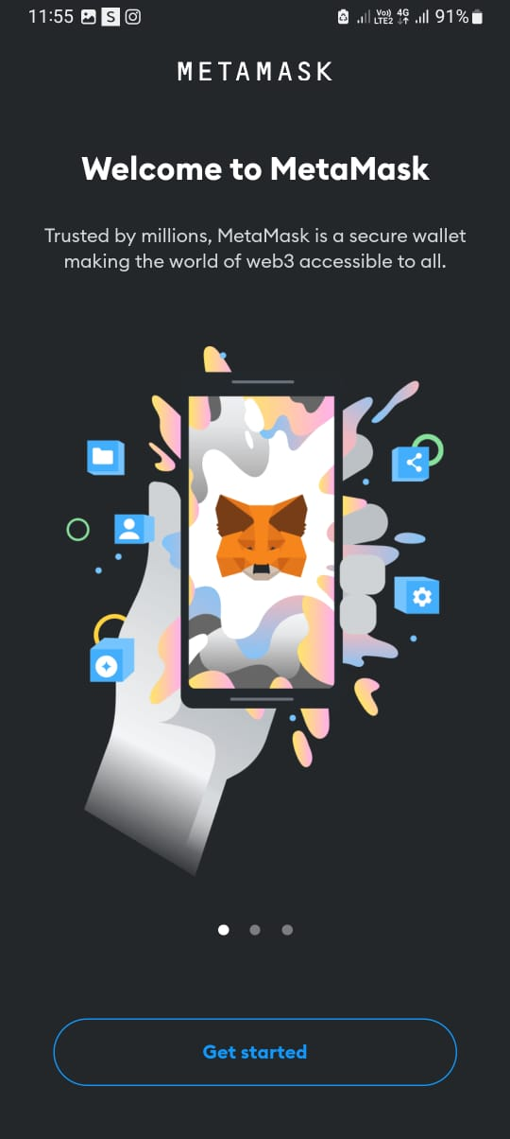
Product/ Feature

Slide 8
THANK YOU
Q&A

